Slide 1
Android Development
Fundamental

Slide 2
Agenda
Development Environment
Getting Start with Android Development
Effective Navigation
Multi-pane Layouts
Interactive
Custom UI

Slide 3
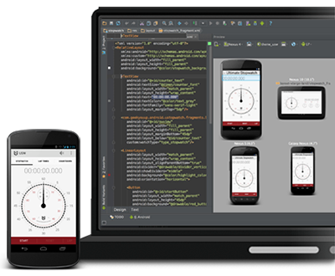
IDE Options
Get the ADT Bundle
Based on Eclipse (ADT Bundle)
SDK Manager
Get from here
Upgrade an Existing IDE
Eclipse Plugin - Android Development Tools (ADT)
SDK Manager
Get the Android Studio
Based on IntelliJ IDEA
SDK Manager
Get from here

Slide 4
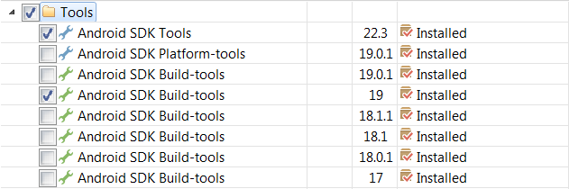
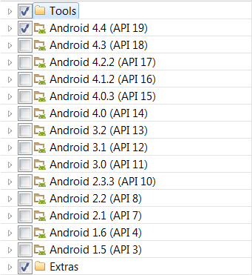
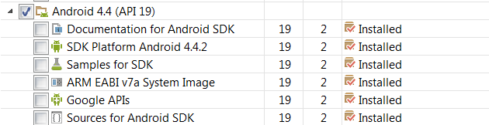
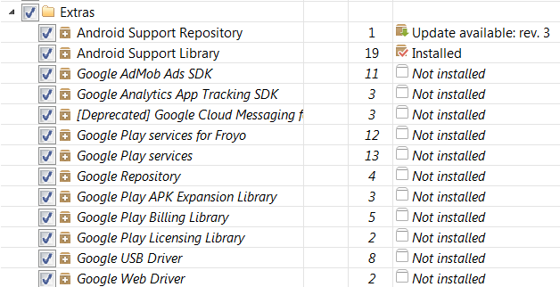
SDK Manager

Slide 5
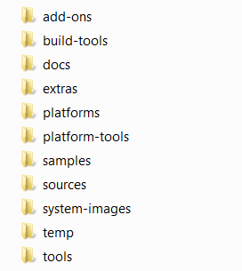
SDK Composition
SDK add-on for special Google APIs, such as map
Tools for app compile
Offline documentation for the Android platform APIs
Static library to use powerful APIs, such as GCM
Android.jar file with a fully compliant Android library
Platform-dependent tools for developing and debugging, such as ADB
A collection of sample apps
Source for Android.jar
System images (ARM and x86)
Temporary files
Tools for debugging and testing, plus other utilities

Slide 6
Agenda
Development Environment
Getting Start with Android Development
Effective Navigation
Multi-pane Layouts
Interactive
Custom UI

Slide 7
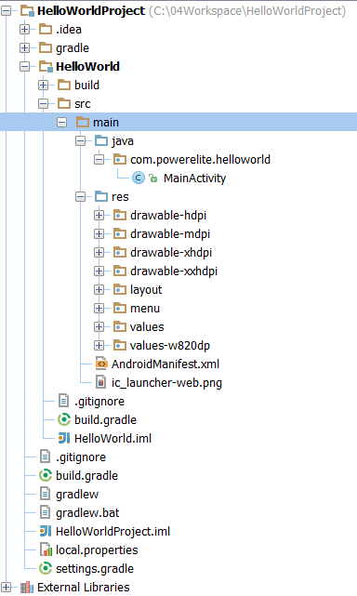
Build the App
Source for Java class files
Resources, such as images, layouts, menus, values, etc
00
To describe the fundamental characteristics of the app and defines each of its components

Slide 8
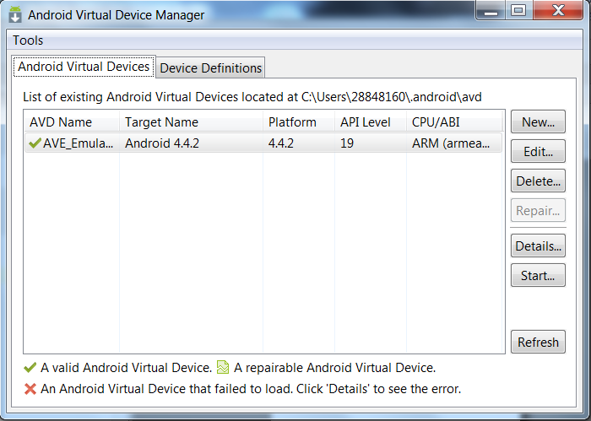
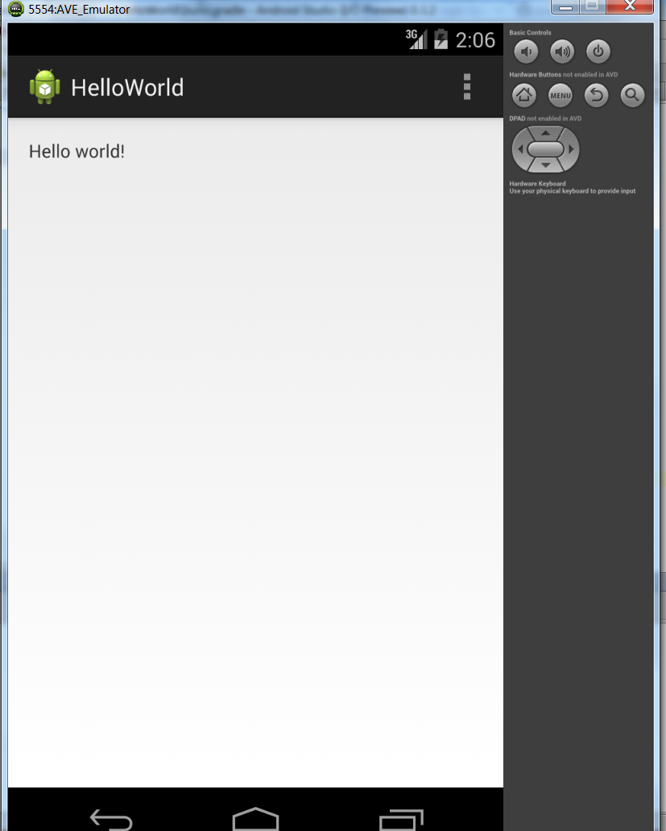
Run the App
\app directory>ant debug
\app directory>adb install bin/MyFirstApp-debug.apk

Slide 9
Logs of App Launch
Waiting for device.
Target device: AVE_Emulator [emulator-5554]
Uploading file
local path: C:\04Workspace\HelloWorldProject\HelloWorld\build\apk\HelloWorld-debug-unaligned.apk
remote path: /data/local/tmp/com.powerelite.helloworld
Installing com.powerelite.helloworld
DEVICE SHELL COMMAND: pm install -r "/data/local/tmp/com.powerelite.helloworld"
pkg: /data/local/tmp/com.powerelite.helloworld
Success
Launching application: com.powerelite.helloworld/com.powerelite.helloworld.MainActivity.
DEVICE SHELL COMMAND: am start -n "com.powerelite.helloworld/com.powerelite.helloworld.MainActivity" -a android.intent.action.MAIN -c android.intent.category.LAUNCHER
Starting: Intent { act=android.intent.action.MAIN cat=[android.intent.category.LAUNCHER] cmp=com.powerelite.helloworld/.MainActivity }

Slide 10
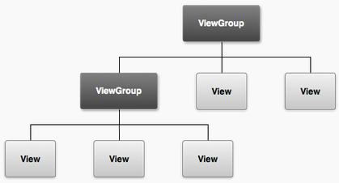
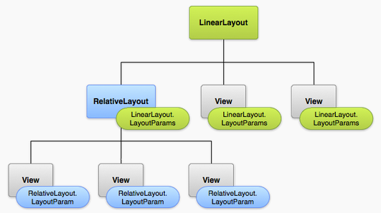
Hierarchy Tree
The user interface for each component of your app is defined using a hierarchy of View and ViewGroup objects
Each view group is an invisible container that organizes child views

Slide 11
View
View class represents the basic building block for user interface components
View is the base class for widgets, which are used to create interactive UI components, such as TextView, etc
Common operations on view
--Set properties
--Set focus
--Set listeners
--Set visibility
Note: The Android framework is responsible for measuring the size and drawing views

Slide 12
ViewGroup
The class that ViewGroup class is the base class for layouts and views containers
-- A ViewGroup is a special view that can contain child views
The static class that ViewGroup.LayoutParams is used by views to tell their parents how they want to be laid out
-- Attributes that android:layout_height and android:layout_width
MATCH_PARENT: view wants to be as big as its parent
WRAP_CONTENT: view wants to be just big enough to enclose its content
An exact number (dp unit)

Slide 13
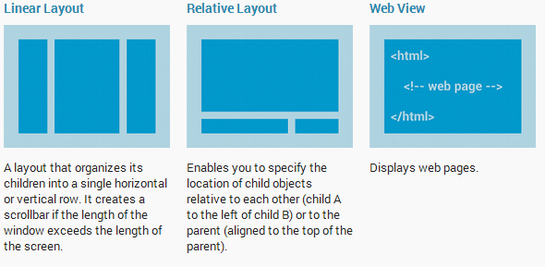
Common Layout

Slide 14

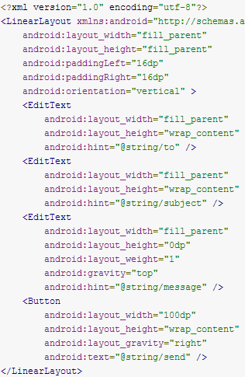
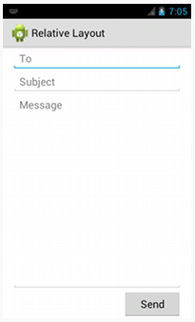
Liner Layout
If ‘height’ is 0, then that view fills whatever space remains after all views are given the space they require.
When ‘weight’ is specified, ‘height’ should be set to be 0dp instead of wrap_content, because setting the ‘weight’ will cause a ‘height’ calculation as we set wrap_content for ‘height’

Slide 15
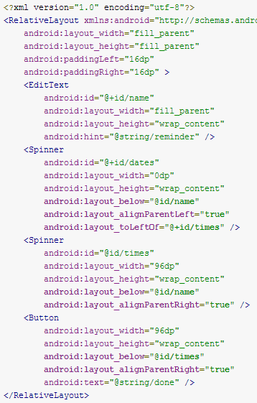

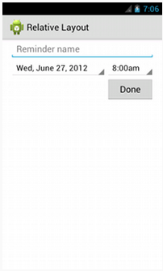
Relative Layout

Slide 16
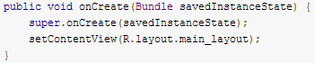
Activity
An activity is a single, focused thing that the user can do.
-- It interacts with the user, so the Activity class takes care of creating a window in which we can place your UI with setContentView(View).

Slide 17
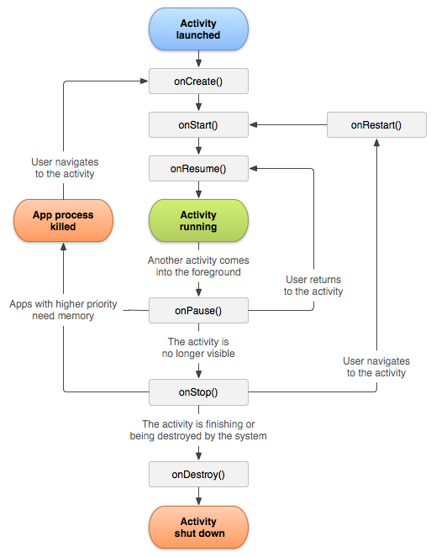
Activity Lifecycle
Entire Lifetime
Visible Lifetime
Foreground Lifetime

Slide 18
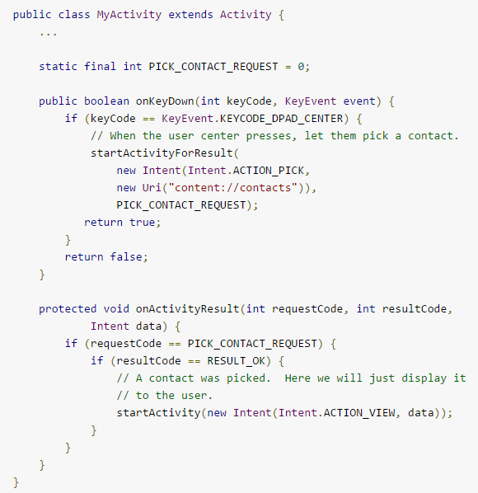
One Activity starts Another Activity
Async

Slide 19
Android Debug Bridge
ADB that A command line tool (C/S) that lets you communicate with an emulator instance or connected Android-powered device.
Syntax: adb [-d|-e|-s <serialNumber>] <command>
Direct an adb command to the only attached USB device.
Direct an adb command to the only running emulator instance.
Direct an adb command a specific emulator/device instance
Get more about ADB from here

Slide 20
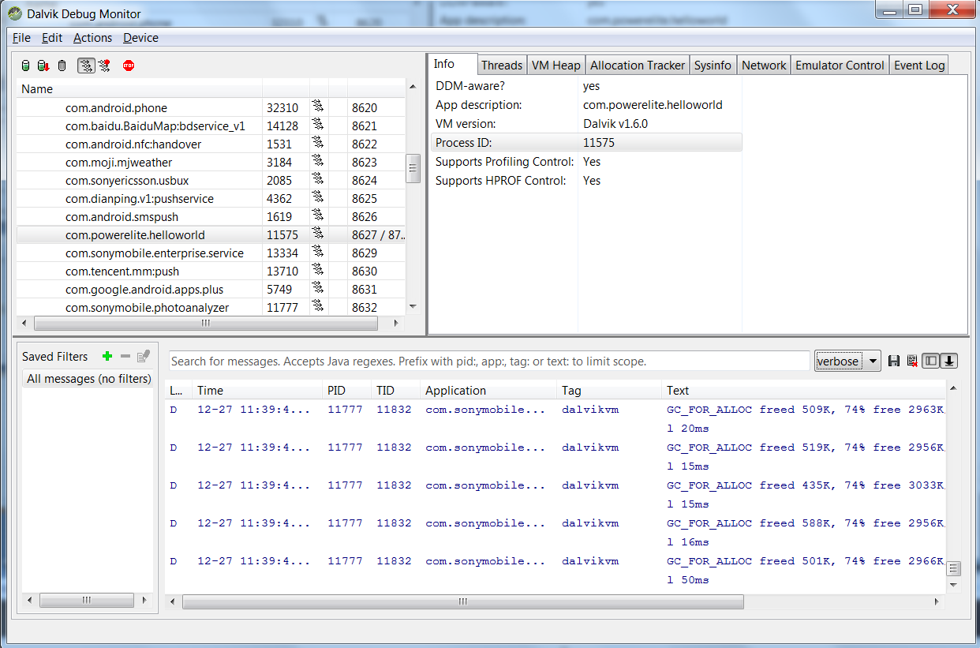
DDMS (Dalvik Debug Monitor Server)
Get more about DDMS from here

Slide 21
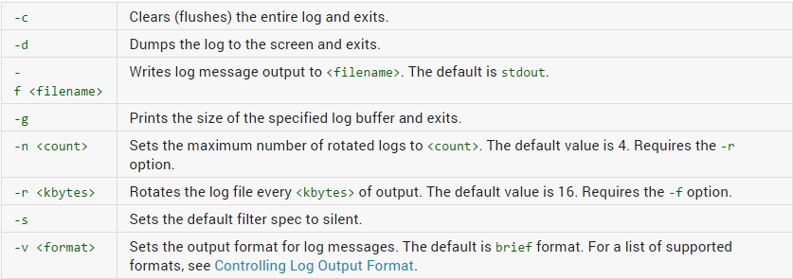
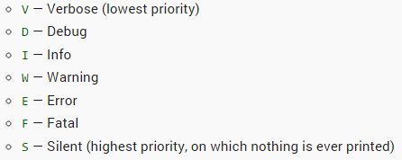
Logcat
The Log Class
Log.v(String, String) (verbose)
Log.d(String, String) (debug)
Log.i(String, String) (information)
Log.w(String, String) (warning)
Log.e(String, String) (error)
logcat
[adb] logcat [<option>] ... [<filter-spec>] ...
Example:
adb logcat ActivityManager:I MyApp:D *:S >c:\logcat.txt
Tag
Filter
Get more about Logcat from here

Slide 22
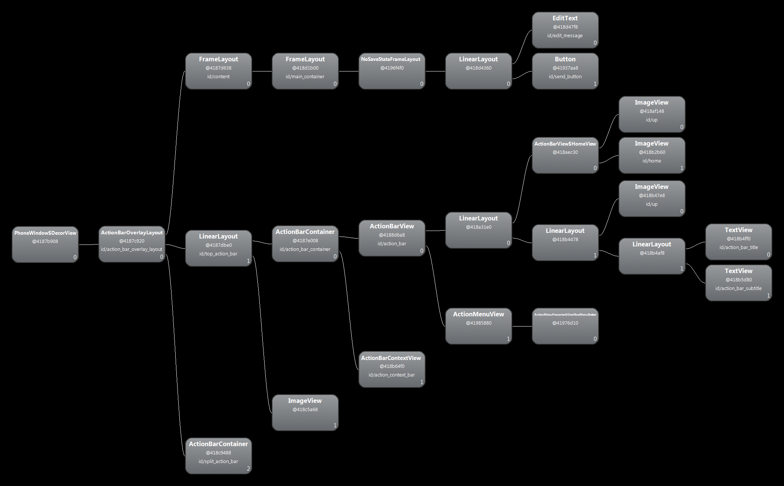
Hierarchy Viewer
Get more about Hierarchy Viewer from here

Slide 23
Agenda
Development Environment
Getting Start with Android Development
Effective Navigation
Multi-pane Layouts
Interactive
Custom UI

Slide 24
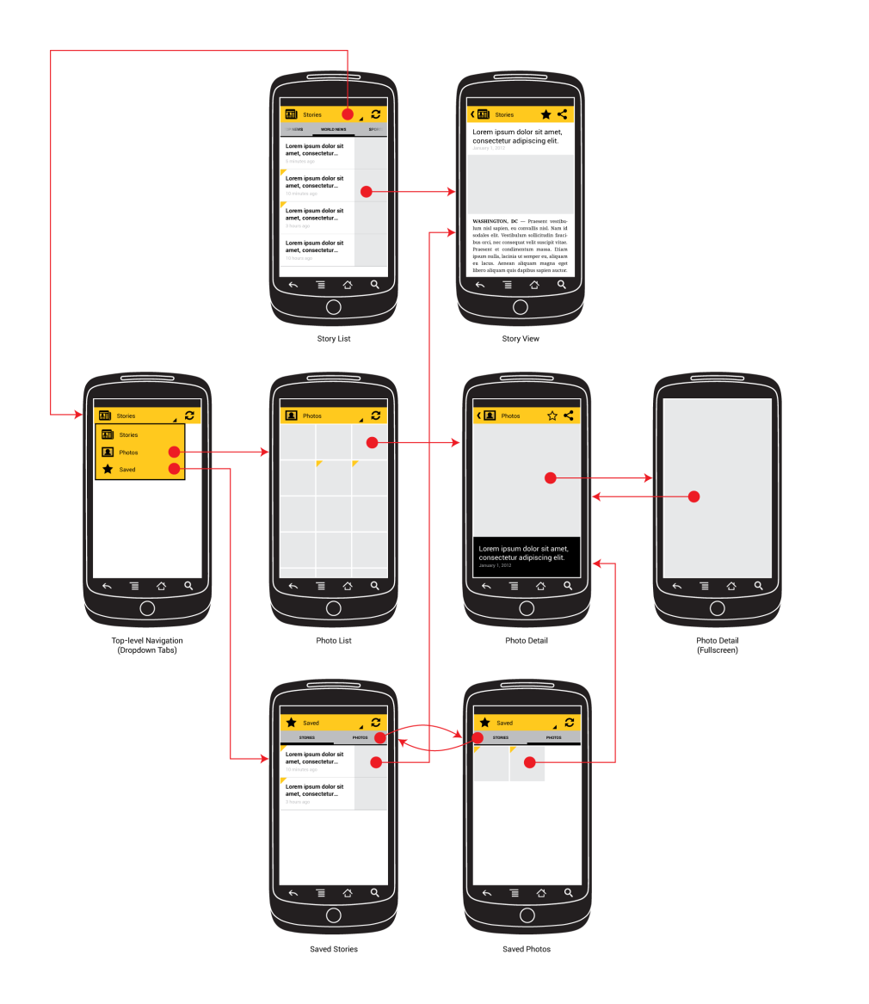
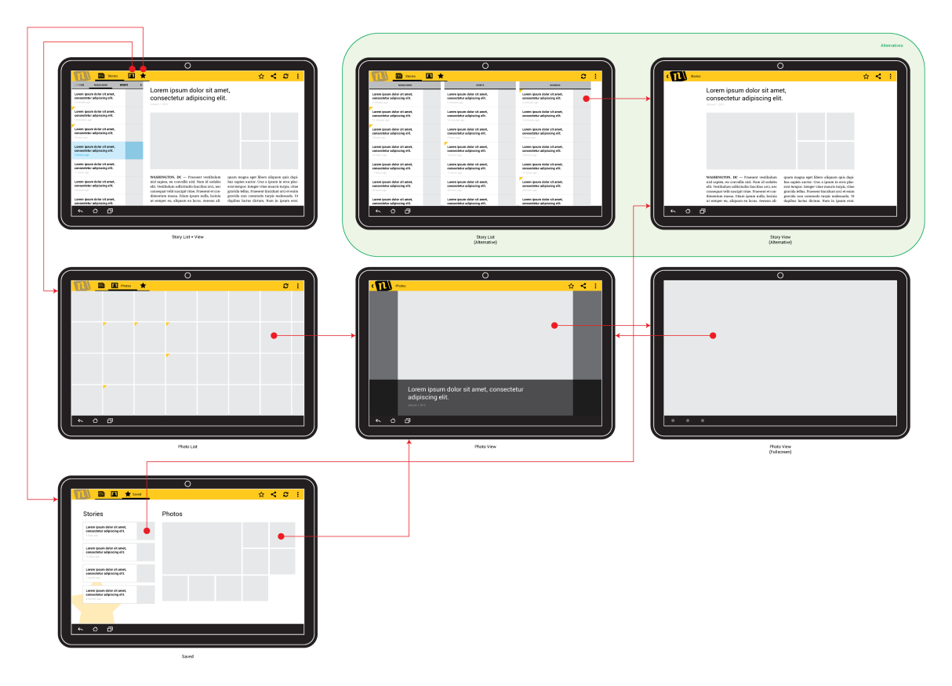
Example @ News App
News app allows users to browse through a set of categorized news stories and photos.

Slide 25
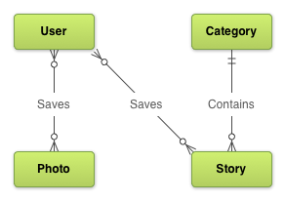
App Information Model
Use entity-relationship diagrams (ERDs) to describe an application's information model.

Slide 26
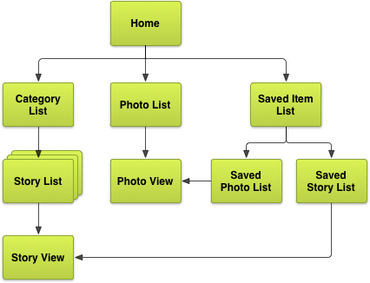
The Screens
Determine the exhaustive set of screens needed to enable users to effectively discover, view, and act upon the data

Slide 27
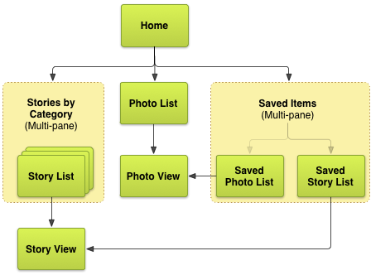
The Combination
Plan the combination of screens in groups to support multiple touchsreen sizes by multi-pane layout

Slide 28
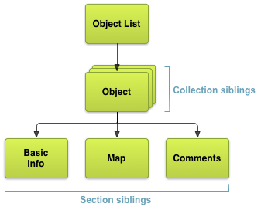
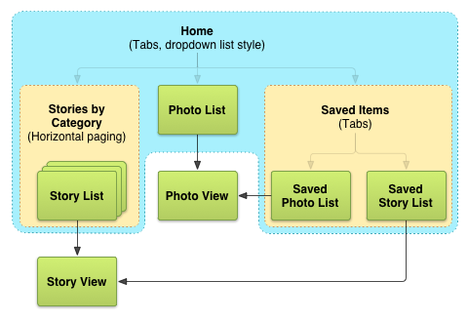
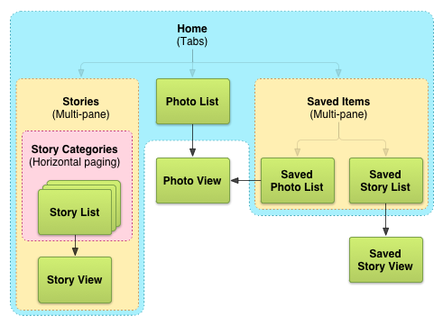
The Navigation
Plan navigation among screens
For example, one section may show textual information about an object while another may provide a map of the object's geographic location.
Lateral Navigation
Descent Navigation

Slide 29
Agenda
Development Environment
Getting Start with Android Development
Effective Navigation
Multi-pane Layouts
Interactive
Custom UI

Slide 30
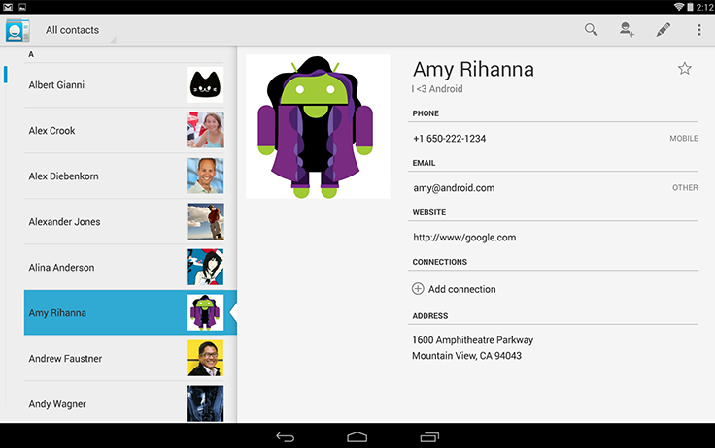
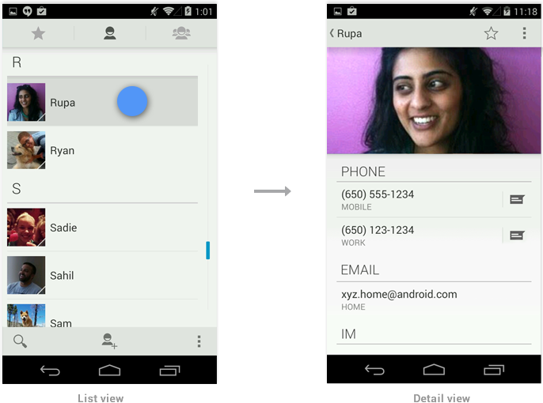
Key Challenge of Android Development
Android devices come in many different screen sizes and types, such as tablet, mobile, …

Slide 31
Multiple Screen Supporting
Android powers hundreds of device types with several different screen sizes, ranging from small phones to large TV sets.
--Use wrap_content and match_parent instead of hard code to the size of element in layout
--Use RelativeLayout instead of absolute layout
--Use dp (Density-independent pixel) instead of pixel
--Use the qualifier to distinguish the layouts and drawables
--Use Nine-patch Bitmaps (define the way of scale by own)

Slide 32
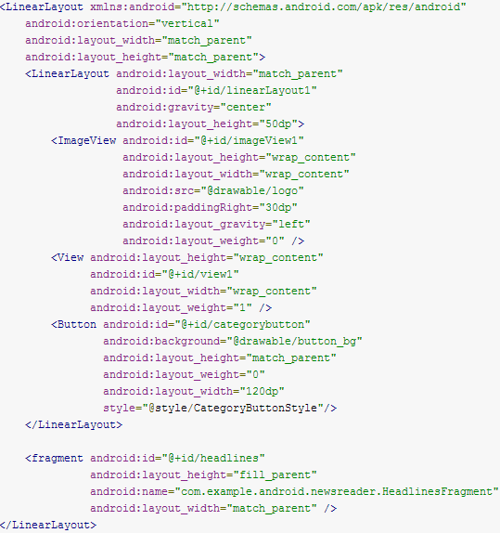
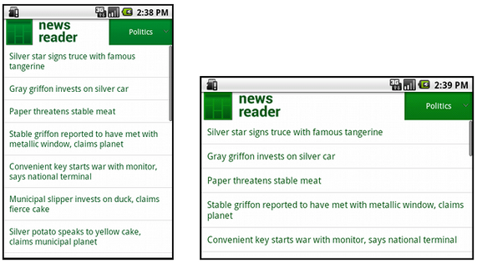
wrap_content & match_parent
Indicates how much of the extra space in the LinearLayout will be allocated to the
Specify 0 if the view should not be stretched.

Slide 33
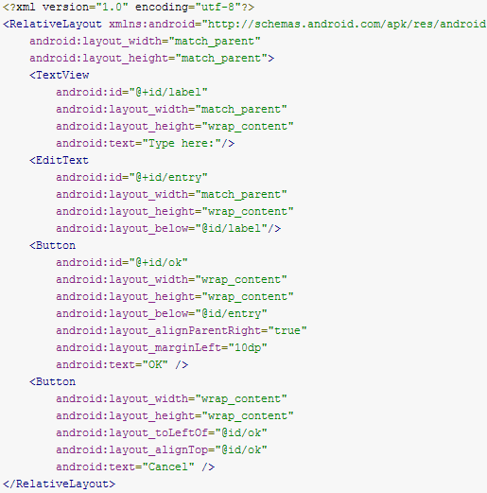
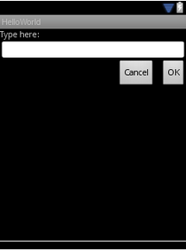
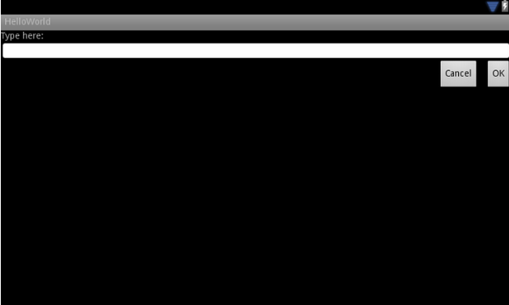
Relative Layout instead of Absolute Layout
System help manage the layout of them relatively

Slide 34
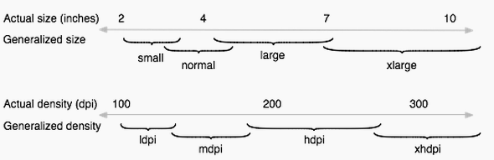
Terminology about the Spec of Screen
Screen size – 4 inch, 5 inch, 7 inch, 10 inch
Screen density – dpi (dots per inch)
Orientation – landscape and portrait
Resolution – numbers of physical pixels 1024x768
density-independent pixel (dp) - virtual pixel unit
The density-independent pixel is equivalent to one physical pixel on a 160 dpi screen (160dpi/mdpi baseline)
The conversion of dp units to screen pixels is px = dp * (dpi / 160)

Slide 35
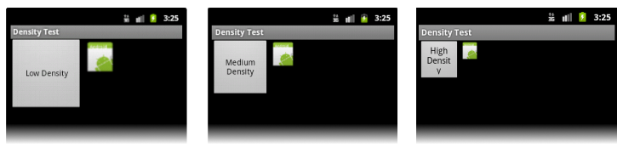
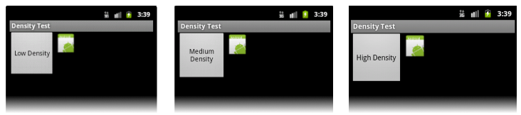
Why dp unit
Because the baseline for density-independent pixels is a medium-density screen, so the device with a medium-density screen looks the same.
For the low-density and high-density screens, the system scales the density-independent pixel values down and up, respectively, to fit the screen as appropriate.
Pixel unit
Scale dp down
same
Scale dp up
dp unit

Slide 36
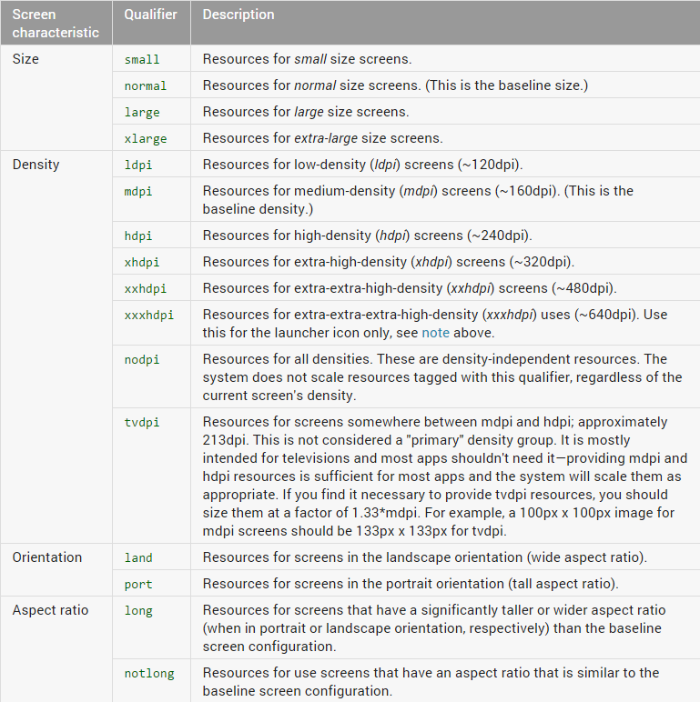
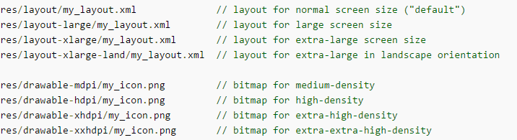
Qualifier (Layout and Drawable)

Slide 37
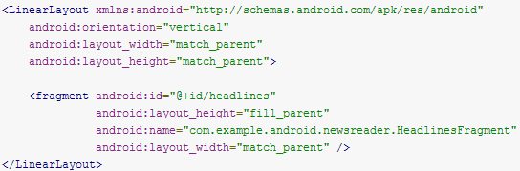
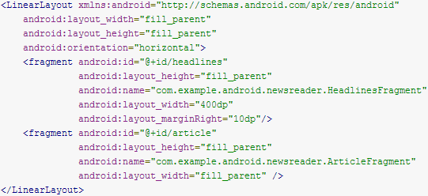
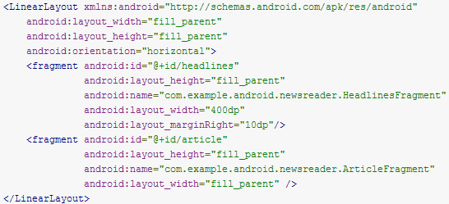
Layout Qualifier
Deprecated
Two panes layout
res/layout-large/main.xml
Single pane layout
res/layout/main.xml
Same
Smallest-width qualifier introduced since 3.2 for tablet
Two panes layout
res/layout-sw600dp/main.xml
System will select the appropriate layout for different screen size
To support tablet both for pre3.2 and after3.2, then we have to copy the same content from layout-large to layou-sw600dp

Slide 38
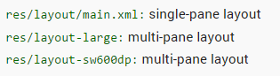
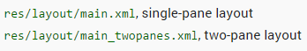
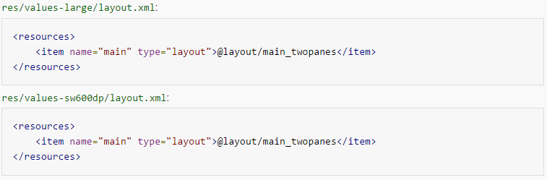
Layout Aliases
Duplicated content between layout-large and layout-sw600dp
Create layout once but support tablet both for pre3.2 and after3.2

Slide 39
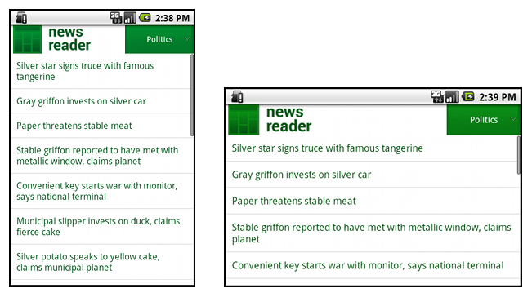
Example @ News Reader
small screen, portrait: single pane, with logo
small screen, landscape: single pane, with logo
7" tablet, portrait: single pane, with action bar
7" tablet, landscape: dual pane, wide, with action bar
10" tablet, portrait: dual pane, narrow, with action bar
10" tablet, landscape: dual pane, wide, with action bar
TV, landscape: dual pane, wide, with action bar

Slide 40




Identify all possible Layouts
res/layout/onepane.xml
res/layout/twopanes.xml
res/layout/twopanes_narrow.xml
res/layout/onepane_with_bar.xml

Slide 41

Map the Layout to each Configuration by Alias
Mobile
Tablet
Legacy Tablet

Slide 42


Drawable Qualifier
Why: bitmap scaling can result in blurry or pixelated bitmaps, so we should provide alternative bitmap resources for different densities.
Follow the 3:4:6:8:12:16 scaling ratio between the six generalized densities
36x36 (0.75x) for low-density
48x48 (1.0x baseline) for medium-density
72x72 (1.5x) for high-density
96x96 (2.0x) for extra-high-density
180x180 (3.0x) for extra-extra-high-density
192x192 (4.0x) for extra-extra-extra-high-density (launcher icon only)

Slide 43



Nine-patch Bitmaps
Use nine-patch bitmaps, which are specially formatted PNG files that indicate which areas can and cannot be stretched or shrinked.
draw9patch utility of the SDK
button.png
button.9.png
Notice the black pixels along the borders.
--The ones on the top and left borders indicate the places where the image can be stretched
--The ones on the right and bottom borders indicate where the content should be hold

Slide 44
Fragment
A Fragment represents a behavior or a portion of user interface in an Activity.
Combine multiple fragments in a single activity
Reuse a fragment in multiple activities
Has its own lifecycle, but its lifecycle is directly affected by the host activity's lifecycle
Receives its own input events
Insert a fragment into host activity layout by declaring the element <fragment> in the activity's layout file, which lives in a ViewGroup inside, such as FrameLayout, …
Use a fragment without its own UI as an invisible worker for the activity

Slide 45

Fragment Lifecycle
Called when the activity's onCreate
method has returned
Interpretation as below status
Resumed: fragment is visible in foreground activity
Paused: another foreground activity is on top of the activity that fragment live in
Stopped: fragment host activity is stopped or fragment is removed
Helper class
DialogFragment:
ListFragment
PreferenceFragment
WebViewFragment

Slide 46


Fragment Legacy Support
Using the Support Library to support legacy device

Slide 47
Example @ Layout XML
res/layout-land/fragment_layout.xml
<LinearLayout xmlns:android=http://schemas.android.com/apk/res/android android:orientation="horizontal“ android:layout_width="match_parent" android:layout_height="match_parent"> <fragment class="com.example.android.apis.app.FragmentLayout$TitlesFragment“ android:id="@+id/titles" android:layout_weight="1“ android:layout_width="0px" android:layout_height="match_parent" /> <FrameLayout android:id="@+id/details" android:layout_weight="1“ android:layout_width="0px" android:layout_height="match_parent“ android:background="?android:attr/detailsElementBackground" />
</LinearLayout>
res/layout/fragment_layout.xml
<FrameLayout xmlns:android=http://schemas.android.com/apk/res/android android:layout_width="match_parent" android:layout_height="match_parent"> <fragment class="com.example.android.apis.app.FragmentLayout$TitlesFragment" android:id="@+id/titles" android:layout_width="match_parent" android:layout_height="match_parent" />
</FrameLayout>

Slide 48
Example @ Class - TitleFragment
src/TitleFragment.java
public static class TitlesFragment extends ListFragment { boolean mDualPane; … @Override public void onActivityCreated(Bundle savedInstanceState) { … // Check to see if we have a frame in which to embed the details fragment directly in View detailsFrame = getActivity().findViewById(R.id.details); mDualPane = detailsFrame != null && detailsFrame.getVisibility() == View.VISIBLE; … if (mDualPane) { // In dual-pane mode, the list view highlights the selected item. getListView().setChoiceMode(ListView.CHOICE_MODE_SINGLE); showDetails(mCurCheckPosition); } } … @Override public void onListItemClick(ListView l, View v, int position, long id) { showDetails(position); } void showDetails(int index) {
… }
}

Slide 49
Example @ Method - showDetails
src/TitleFragment.java
void showDetails(int index) { mCurCheckPosition = index; if (mDualPane) { // We can display everything in-place with fragments, so update the list to highlight the selected item getListView().setItemChecked(index, true); // Check what fragment is currently shown, replace if needed. DetailsFragment details = (DetailsFragment) getFragmentManager().findFragmentById(R.id.details); if (details == null || details.getShownIndex() != index) { // Make new fragment to show this selection. details = DetailsFragment.newInstance(index); // Execute a transaction, replacing any existing fragment with this one inside the frame. FragmentTransaction ft = getFragmentManager().beginTransaction(); if (index == 0) { ft.replace(R.id.details, details); } else { ft.replace(R.id.a_item, details); } ft.setTransition(FragmentTransaction.TRANSIT_FRAGMENT_FADE); ft.commit(); } } else { // Otherwise we need to launch a new activity to display the dialog fragment with selected text. Intent intent = new Intent(); intent.setClass(getActivity(), DetailsActivity.class); intent.putExtra("index", index); startActivity(intent); }
}

Slide 50
Example @ Class - DetailsFragment
src/DetailsFragment.java
public static class DetailsFragment extends Fragment { public static DetailsFragment newInstance(int index) { DetailsFragment f = new DetailsFragment(); // Supply index input as an argument. Bundle args = new Bundle(); args.putInt("index", index); f.setArguments(args); return f; } public int getShownIndex() { return getArguments().getInt("index", 0); } @Override public View onCreateView(LayoutInflater inflater, ViewGroup container, Bundle savedInstanceState) { if (container == null) { return null; } ScrollView scroller = new ScrollView(getActivity()); TextView text = new TextView(getActivity()); int padding = (int)TypedValue.applyDimension(TypedValue.COMPLEX_UNIT_DIP, 4, getActivity().getResources().getDisplayMetrics()); text.setPadding(padding, padding, padding, padding); scroller.addView(text); text.setText(Shakespeare.DIALOGUE[getShownIndex()]); return scroller; } }

Slide 51
Agenda
Development Environment
Getting Start with Android Development
Effective Navigation
Multi-pane Layouts
Interactive
Custom UI

Slide 52


Menu
Beginning with Android 3.0 (API level 11), Menu button is no longer required to be provided in Android-powered devices
With this change, Android apps should migrate away from a dependence on the traditional 6-item menu panel to present common user actions by ActionBar
Menu
Legacy App

Slide 53

Motivation to declare Static Menu
--Visualize the menu structure in XML.
--Separate the content for the menu from apps’ code
--Create alternative menu configurations for different platform versions, screen sizes, and other configurations
String of menu item
Icon of menu item
Callback of menu item
When and how this item should appear as an action item in the Action Bar

Slide 54


Type #1 Option Menu in ActionBar
Inflate a menu hierarchy from the specified XML resource
Handling click events

Slide 55

Type #2 Contextual Menu
Contextual Action Mode
--It is a system implementation of ActionMode that displays a contextual action bar at the top of the screen with actions that affect the selected item(s).

Slide 56


Contextual Action Mode
ActionMode: Represents a contextual mode of the user interface.
CB for action mode
Get menu inflater
Inflate a menu hierarchy from the specified XML resource
Handling click events of menu items in ActionMode
Start an contextual action bar

Slide 57


Example @ Contextual Action Mode in ListView
Enable multi selection in ListView
Get menu infalter
Inflate a menu hierarchy from the specified XML resource
Respond to clicks on the actions in the contextual action bar

Slide 58


Reuse Menu Pattern among Activities
All activities extend this class for each activity that should share the same options menu
Add menu items to one of the descendant activities, override onCreateOptionsMenu() in that activity

Slide 59

Action Bar
Action Bar is to identify the application, and provides user actions and navigation modes.
--Identify the application brand
--Provide consistent navigation and view refinement for app
--Make key actions accessible to the user, just like shortcut
--Hold overflow menu
Brand
Navigation based on Tab
Key
Action
Overflow
Menu

Slide 60

Availability and Compatibility
Action Bar is included in all activities that use Theme.holo since HC3.0 (API 11) by default
Add Action Bar
-- <uses-sdk android:targetSdkVersion="11" />
-- <uses-sdk android:minSdkVersion="11" />
Remove Action Bar

Slide 61



Add Action Items
If menu items could be displayed on the available space, otherwise they will be hidden in overflow menu
Define Menu
Best Practice:
# 1 Always set title for menu item, because if there is no room for that, it will be displayed in overflow menu
# 2 system calls onOptionsItemSelected() in Activity before calling the same callback in Fragment
Inflate a menu hierarchy from the specified XML resource

Slide 62




Enable Navigation among App Stack
Enable navigation
This ID is retrieved when user touches the icon
Navigate the user to the specified activity within app or other app
The other activities on top of it will be closed
When the user touches "up", the new activity is not added to the current task

Slide 63



Add Action View
Declares that the action view should be collapsed
(custom) widget class to serve action view
CB to be invoked when a menu item is expanded or collapsed

Slide 64



Add Action Provider
ShareActionProvider is extends from ActionProvider
Find menu item
Find action provider for the menu item
Sets an intent with information about the share action, such as image, text, …
Customize the shared history for different targets, such as image, text, …

Slide 65



Add Navigation Tab
Require an object of type T to extend Fragment
Make the tabs visible
Get context from activity
Add tabs to Action Bar
Disable the activity title if it is duplicated with title of Action Bar
Instantiate Fragment for activity
Attach Fragment on activity
Detach Fragment from activity

Slide 66


Add Drop-down Navigation
New ArrayAdapter extends from SpinnerAdapter
Enable navigation in Action Bar
CB for Drop-down navigation
Apply the adapter for the Drop-down navigation

Slide 67


Notification
A notification is a message you can display to the user outside of application's normal UI
--Appear as an icon in the notification area
--Open the notification drawer to see the details of it

Slide 68


The Style
Normal view:
The standard view of the notifications in the notification drawer
Big view:
A large view that's visible when the notification is expanded, which is introduced in Android4.1
Content title
Content title
Large icon
Time that the notification was issued.
Time that the notification was issued.
Detail info of Content context
Large icon
Content info
Small icon
Content text
Small icon
Content text
Content info

Slide 69


Build Notification
New Builder for Notification
Pair intent with Activity will be launched
Build artificial stack to let ResultActivity on top of stack
Intent to be sent to notification manager
Get system service NotificationMgr to Post a notification to be shown in the status bar
InboxStyle: generate large-format notifications that include a list of (up to 5) strings
Set title of InboxStyle
Add items to the list of InboxStyle
Set the InboxStyle to Notification Builder

Slide 70


Manage Notification Update
Notification with the same id has already been posted by your application and has not yet been canceled, it will be replaced by the updated information, but NOT been created again

Slide 71


Back to Parent Activity by Persevered Flow
MainActivity is ResultActivity’s parent activity
Specify the stack of app Activities
Pair intent with Activity will be launched
Build artificial stack to let ResultActivity on top of stack
Intent to be sent to notification manager
Get system service NotificationMgr to Post a notification to be shown in the status bar

Slide 72


ResultActivity as a New Task
This Activity is ONLY seen if it's started from a notification
Pair intent with Activity will be launched
Set flag for intent to specify that to launch activity in NEW Empty task
Single task is NOT related to other task and is NOT visible on recent task list
Intent to be sent to notification manager
Get system service NotificationMgr to Post a notification to be shown in the status bar

Slide 73


Determinate Indicator
Know how long the operation takes and how much of it is complete
New thread
to update the progress determinately
Update text of Notification and remove ProgressBar

Slide 74


Indeterminate Indicator
Not know how long the operation takes and how much of it is complete
New thread
update the progress indeterminately
Update text of Notification and remove ProgressBar

Slide 75
Agenda
Development Environment
Getting Start with Android Development
Effective Navigation
Multi-pane Layouts
Interactive
Custom UI

Slide 76
Custom Component
To create custom view if existing view class and subclass (widget) can NOT satisfy the request
--Create a completely custom View component
--Combine a group of View components into a new single component
--Override the way of existing View components
--Capture and handle events in some custom way
Steps to simply make custom view
--Overriding onDraw
--Overriding onMeasure to do calculation
--Creating XML to store attributes
--Handling touch events

Slide 77

Example @ Custom View
Make a View to draw text rotated around a central point

Slide 78


Declare the Layout
3 views
Custom View
Inflate layout for the Activity

Slide 79



Custom View Class - Drawing
Extend from View class
Paint to describe the drawing
Constructor that is called when inflating a view from XML
Called when the view should render its content.
get the Width & Height of the view
The Canvas class holds the "draw" calls
A Bitmap to hold the pixels
A Canvas to host the draw calls on bitmap
A drawing primitive (e.g. Rect, text, Bitmap)
A paint to describe the colors and styles for the drawing

Slide 80


Custom View Class - Measuring
Called to determine the size requirements for this view and all of its children.
Measure width and height according to spec
To store the measured width & height of view

Slide 81

Custom View Class: adjustTextSizetoFit Method
Measure if space of canvas is big enough to draw the text

Slide 82

Example @ Custom View with Custom Style

Slide 83



Custom View with Custom Style
Apply for Custom Style in View class
Inflate layout that is made of custom view for Activity

Slide 84


Apply for the Custom Style
Apply for Custom Style when Custom View is created
Get Custom Style

Slide 85
Reference
http://en.wikipedia.org/wiki
http://developer.android.com

